Slide 1
FUNCTION GROUPS AND FUNCTION MODULES
-Surbhi S Jain
-Pooja L Jain
-Subham Ankit Karan
-Uttam Sinha

Slide 2
MODULARISATION
1. Avoid redundancy.
2. Make your program easy to read and improve their structure.
3. Re-use program components.
Modularisation can be implemented using:
1. Internal subroutines
The subroutine and the call are in the same program.
2. External subroutines
The subroutine is in an external program.
3. Function modules
The subroutines is stored in the function library.

Slide 3
DIFFERENCE BETWEEN SUBROUTINES AND FUNCTION MODULES
SUBROUTINES | FUNCTION MODULES
HAVE NO EXCEPTION PARAMETERS. | HAVE EXCEPTION PARAMETERS TO CATCH THE EXCEPTION.
CAN BE ACCESSED LOCALLY. | CAN BE ACCESSED GLOBALLY.
CANNOT BE TESTED INDEPENDENTLY. | CAN BE TESTED INDEPENDENTLY.
EXPLICITLY WON’T RETURN ANY VALUE. | EXPLICITLY RETURNS VALUES.
DOESN’T HAVE REMOTE ACCESS. | CAN BE MADE TO HAVE REMOTE ACCESS.
CANNOT HAVE OPTIONAL PARAMETERS. | CAN HAVE OPTIONAL PARAMETERS.

Slide 4
FUNCTION GROUP
When you create a function module , you must assign it to function group.
The function group is the main program in which a function module is embedded.
The function group is a program type F , and not executable.
The entire function group is a container for function modules.
When a function modules is called , the entire function group is loaded into the session of the program.
Function group is used to define global data for function modules.

Slide 5
FUNCTION MODULE
It is very similar to an external subroutine in 3 ways:
1. Both exist within an external program.
2. Both enable parameters to be passed and returned.
3. Paramters can be passed by value,by value and result , or by reference.
It is a code that can be called from any ABAP program,therefore making it a globally accessible object.
ABAP program pass data to function module from import parameters or internal tables.

Slide 6
Transaction code SE37 (FUNCTION BUILDER).
FUNCTION GROUPS ACT AS CONTAINERS FOR FUNCTION MODULES THAT LOGICALLY BELONG TOGETHER.
FUNCTION MOULES ALLOW YOU TO ENCAPSULATE AND REUSE GLOBAL FUNCTIONS IN SAP SYSTEM.
THE SAP SYSTEM CONTAINS SEVERAL PREDEFINED FUNCTIONS MODULES THAT CAN BE CALLED FROM ANY ABAP PROGRAM.
FUNCTION MODULES ALSO PAY AN IMPORTANT ROLE DURING UPDATING AND IN INTERACTION BETWEEN DIFFERENT SAP SYSTEMS,OR BETWEEN SAP SYSTEMS AND REMOTE SYSTEMS THROUGH REMOTE COMMUNICATIONS.

Slide 7
To pass parameters to a function module , we must define a function module interface,
Import parameters are variables or field strings that contain values passed into the function module from the calling program . These values originate outside of the function module and they are imported into it.
Export parameters are variables or field strings that contain values returned from the function module . These values originate within the function module and they are exported out of it.

Slide 8
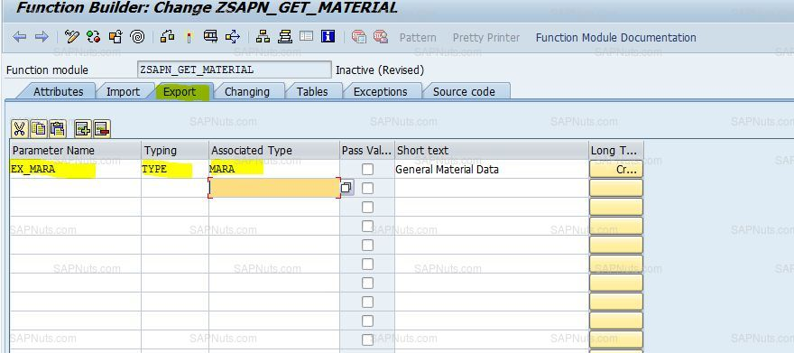
Export

Slide 9
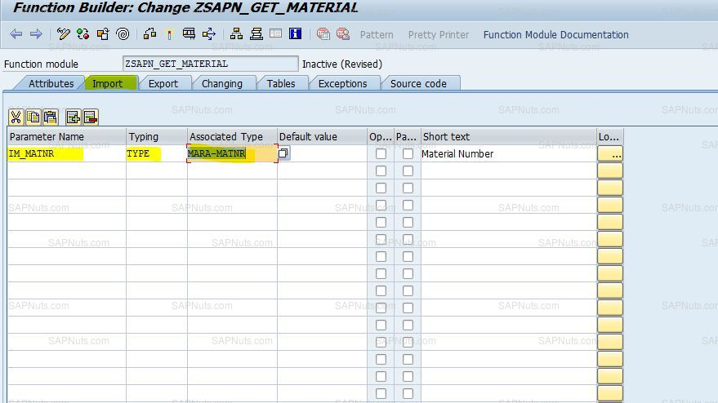
Import

Slide 10
Changing parameters are variables or field strings that contain values that are passed into the function module , changed by the code within the function module , and then returned. These values originate outside the function module. They are passed into it , changed , and passed back.
Table parameters are internal tables that are passed to the function module , changed within it , and returned . The internal tables must be defined in the calling program.
An exception is a name for an error that occurs within a function module . Exceptions are described in the following section.

Slide 11
Passing Parameters
The methods for passing parameters to function modules :
By default :
Import and export parameters are passed by value.
Changing parameters are passed by value and result.
Internal tables are passed byreference.

Slide 12
Types of function module
There are three types -
1. Normal function module : These are works within the system.
2. Remote-enabled module : Function module that can be called from other SAP or non – SAP system. Ex : BAPI.
3. Update function module : It is basically used to bundle distributed updates within different programs spots , to one place.

Slide 13
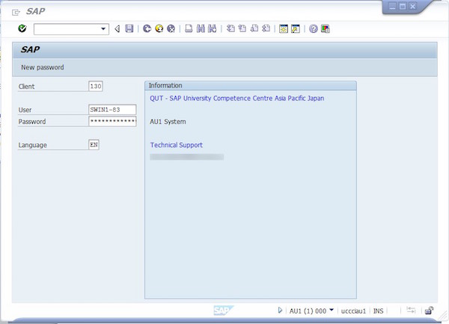
Creating a Function Group
For creating a functional module it should be first assigned to a functional group
Enter the Tcode SE80 in top left dialogue box to create a functional group.

Slide 14
To create a function group, proceed as follows:
1. Choose the Object List For a function group in the Object Navigator.
2. Enter the name of a new function group and press ENTER or the button (be sure to observe the customer namespace). A dialog window appears, asking whether you want to create the new function group.
3. Click Yes to confirm. A dialog box with the attributes of the function group appears.
4. Enter a short text and press the Save button.
5. Assign the function group to a package and a correction request in the next screens.

Slide 15
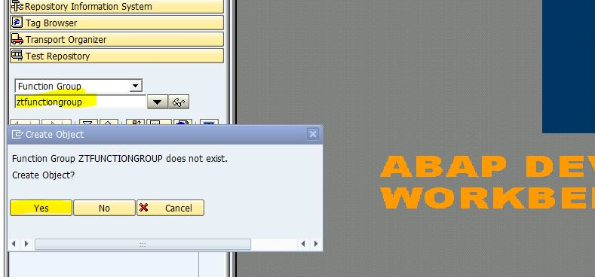

Slide 16
Creating Function Modules
Before you create a new function module , you should search for a suitable function group or create a new one.
Enter the T code se37 n top left dialogue box

Slide 17
To create the function module, proceed as follows:
1. Decide in which function group you want to use to create the new function module.
2. Display the object list for the function group in the navigation area of the Object Navigator.
3. Open the context menu for the function group in the tree structure and choose Create > Function Module. A dialog box with the attributes of the function module appears.
4. Enter a name and a short text for the function module. Be sure to use the customer name space for function modules(customer function modules start with Z_ or Y_). 5. Click the (Save) button.
6. If necessary, assign the function module to a package and a correction request in the next screens.

Slide 18
Some commonly used function modules .
ABAP_DOCU_DOWNLOAD | Download ABAP documentation in HTML format.
APPL_LOG_DISPLAY | With this function module you can analyze logs in the database.
BAL_CNTL_CREATE | Create Control for log display
BAL_DSP_MSG_LONGTEXT | Display message long text
BAL_LOG_MSG_DELETE | Delete message

